Slide 1
Seven Themes of Catholic Social Teaching
Catholic Social Teaching
Document #: TX001967
Notes:
[Teacher’s Note: Resources used for this presentation include the seven social justice themes articulated in various sources from the United States Conference of Catholic Bishops.]

Slide 2
The U.S. Catholic bishops have identified seven themes found in Catholic social teaching. These seven themes were first articulated in the 1998 document Sharing Catholic Social Teaching: Challenges and Directions.

Slide 3
The seven themes are derived from religious truths taught in Scripture and Tradition.
Dignity of the Human Person
Option for the Poor
Rights and Responsibilities
Common Good and Community
Stewardship of God's Creation
Role of Government and Subsidiarity
Economic Justice
“The Church’s social teaching is a rich treasure of wisdom about building a just society and living lives of holiness amidst the challenges of modern society. It offers moral principles and coherent values that are badly needed in our time” (Sharing Catholic Social Teaching, 1998).

Slide 4
Seven Social Justice Themes
The themes do not stand alone; they are interdependent, woven together to support and complement one another.
SOLIDARITY
CARE FOR GOD’S CREATION
Life and Dignity of the Human Person
RIGHTS AND RESPONSIBILITIES
PREFERENTIAL OPTION FOR THE POOR
COMMUNITY
PARTICIPATION
DIGNITY OF WORK AND RIGHTS OF WORKERS

Slide 5
Life and Dignity of the Human Person
Promoting the life and dignity of human beings is the most fundamental theme of Catholic social teaching. It is the core social justice theme and the one on which the other themes are based.
SOLIDARITY
CARE FOR GOD’S CREATION
Life and Dignity of the Human Person
RIGHTS AND RESPONSIBILITIES
PREFERENTIAL OPTION FOR THE POOR
COMMUNITY
PARTICIPATION
DIGNITY OF WORK AND RIGHTS OF WORKERS

Slide 6
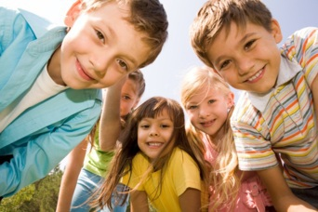
Image in shutterstock
Life and Dignity of the Human Person
The Church teaches:
All human beings are made in the image and likeness of God.
All human beings have God-given dignity.
Christians are called to respect and protect human life and dignity.
Respecting human life and dignity means more than simply allowing others to live. It also means helping others to live to the fullest—to thrive physically, socially, mentally, and spiritually.

Slide 7
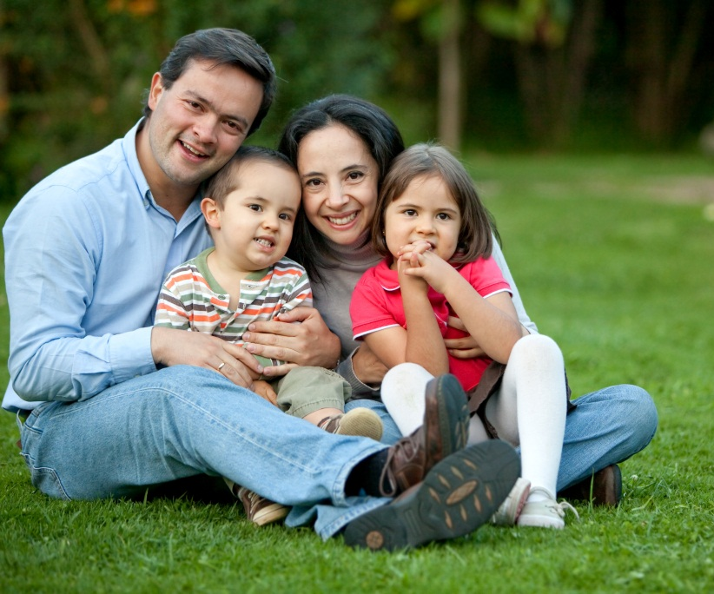
Call to Family, Community, and Participation
Human beings are created by God to be social creatures, to live in fellowship and community. The U.S. bishops state that each person is not only sacred but social.
The support and protection of the family must have the highest priority in society. The family also has a right and responsibility to participate in society.
Image in shutterstock
God calls us not only to support and nurture our families but also to participate in the local community, nation, and world, caring for our brothers and sisters in Christ and constantly working to promote the common good.

Slide 8
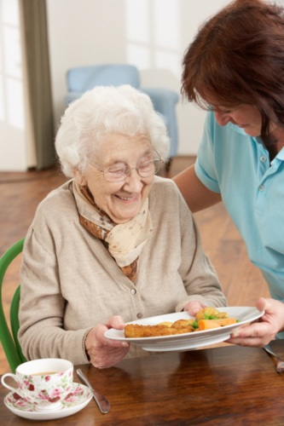
Rights and Responsibilities
All human beings have a right to life and to having their basic needs met, such as food, shelter, clothing, medical care, and employment.
Along with these rights come responsibilities, such as contributing to and participating in society and promoting the common good.
Image in shutterstock

Slide 9
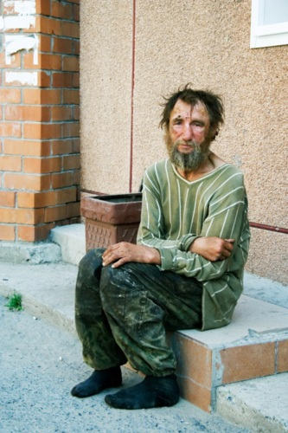
Preferential Option for the Poor
The Church has always emphasized that individuals and society must have a special concern for people who are poor and vulnerable. This concern is rooted in the moral principle that Church teaching calls the universal destination of goods.
The “universal destination of goods” is the principle that the earth and all its goods belong to God, and he intends these goods to provide the things all human beings need to live with dignity.
Image in shutterstock

Slide 10
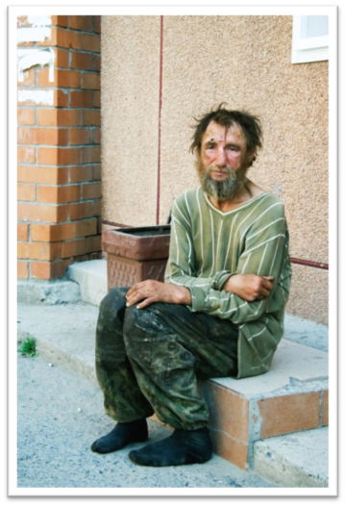
Preferential Option for the Poor (continued)
The preferential option for the poor has two parts:
1. It involves freely choosing to become friends or partners with those who are poor, and taking on their problems as our problems.
2. The option for poor and vulnerable people means a commitment to take action to transform any injustices that prevent them from realizing their God-given dignity. We need to become a “voice for the voiceless.”
Image in shutterstock

Slide 11
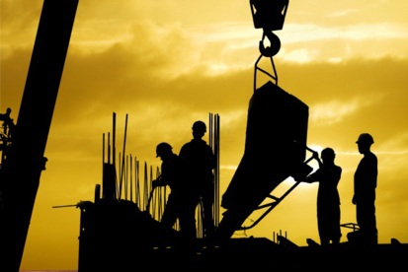
Dignity of Work and the Rights of Workers
Image in shutterstock
Catholic social teaching tells us, “The basis for determining the value of human work is . . . the fact that the one who is doing it is a person” (On Human Work, 6).
Work, and the economy in general, exists for the sake of people, not the other way around.
The value of work must first be measured by whether it promotes the human dignity of the worker.

Slide 12
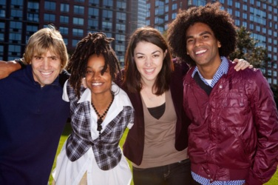
Solidarity
Catholic social teaching says that a spirit of friendship and true community—between individuals, groups, and nations—is the basis for a just world. This is the Catholic social teaching theme of solidarity.
Image in shutterstock
Solidarity is based on the understanding that all people are part of the same human family, despite our national, racial, ethnic, economic, or ideological differences.
Solidarity calls us to respect every person with the same respect we have for ourselves and to respect the basic rights that flow from each person’s inherent dignity.

Slide 13
Solidarity (continued)
The Church defines the common good as “the sum of those conditions of social life which allow social groups and their individual members relatively thorough and ready access to their own fulfillment” (Pastoral Constitution on the Church in the Modern World, 26).
Image in shutterstock
We must ensure and protect the common good by making sure that every person’s basic needs are met and her or his human rights are respected.

Slide 14
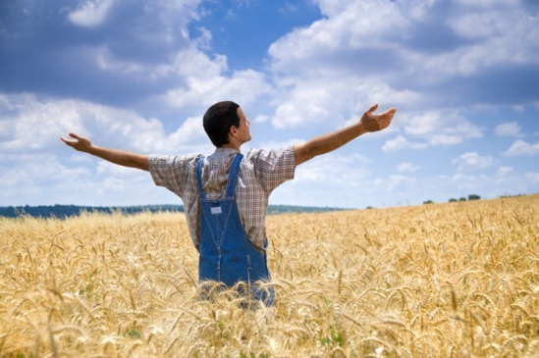
Care for God’s Creation
In the Creation account in the Book of Genesis, God placed Adam in the Garden of Eden “to cultivate and care for it” (2:15), symbolically indicating the human responsibility to care for the earth.
In the first account of Creation, God commanded the man and woman to “fill the earth and subdue it. Have dominion over the fish of the sea, the birds of the air, and all the living things that move on the earth” (Genesis 1:28).

Slide 15
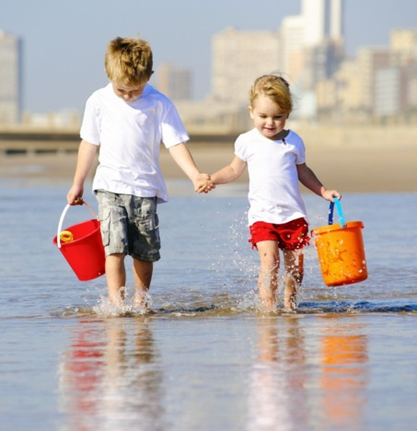
Care for God’s Creation (continued)
The Church interprets the Genesis command as God’s granting stewardship of creation to all human beings.
A steward is someone who takes care of a master’s or employer’s wealth and possessions, a serious responsibility.
In a similar way, God commands all human beings to care for his creation with love.
Image in shutterstock

Slide 16
SOLIDARITY
CARE FOR GOD’S CREATION
Life and Dignity of the Human Person
RIGHTS AND RESPONSIBILITIES
PREFERENTIAL OPTION FOR THE POOR
COMMUNITY
PARTICIPATION
DIGNITY OF WORK AND RIGHTS OF WORKERS
Discussion Questions
How do I incorporate all seven social justice themes in my life?
What is my personal response to carrying out the social justice themes in my daily life?
Notes:
(USCCB documents cited in this presentation are from the United States Conference of Catholic Bishops, and available at www.usccb.org. Copyright © USCCB, Washington, D.C. All rights reserved. No part of this work may be reproduced or transmitted in any form or by any means, electronic or mechanical, including photocopying, recording, or by any information storage and retrieval system, without permission in writing from the copyright owner.
The scriptural quotations in this presentation are from the New American Bible with Revised New Testament and Revised Psalms. Copyright © 1991, 1986, and 1970 by the Confraternity of Christian Doctrine, Washington, D.C. Used by the permission of the copyright owner. All Rights Reserved. No part of the New American Bible may be reproduced in any form without permission in writing from the copyright owner.)

