Slide 1


Preparing for the Advent and Christmas Seasons

Slide 2
- Opening Prayer - Bishop William F. Medley

Slide 3
- Remarks from Bishop Medley -

Slide 4
- Questions for Bishop Medley -

Slide 5
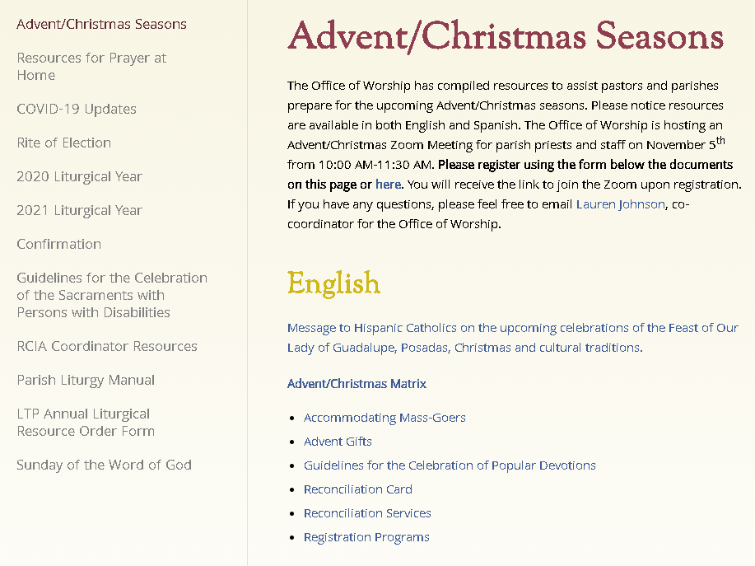
Guidelines and Resources
www.owensborodiocese.org/advent-christmas-seasons

Slide 6
Scheduling
Christmas Eve Mass may start no earlier than 2:00 PM
Remember additional time needed between Masses for cleaning
Additional Masses?
Don’t start heavy, add only if necessary
Coordinate with surrounding parishes
Online sign-ups
No obligation; inform of livestream opportunities available
Encourage parishioners to pick one Mass either on:
Thursday (Christmas Eve)
Friday (Christmas)
Saturday (Feast of St. Stephen)
Sunday (Holy Family)
During the entire Octave (ends on January 1, Solemnity of Mary, Mother of God)
Be flexible, conditions are ever-changing

Slide 7
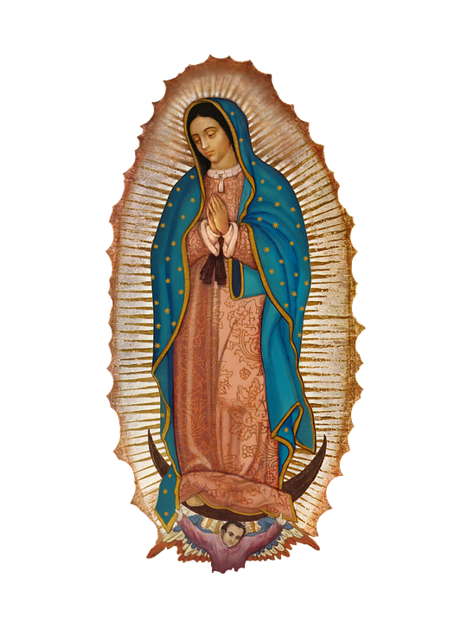
Liturgy Preparations
Don’t wait to communicate!
Lectors, EMHC, servers, musicians, etc.
Prepare comprehensive, disposable + digital worship aids if possible (more later on copyright)
Include responses, Creed, simple Communion instructions (spiritual Communion prayer for those participating via livestream), etc.
In the back, simple ideas for celebrating Catholic faith with family during these seasons (prayers, activity, encouraging them to visit the church for adoration, etc.)
Reminders:
Solemnity of the Immaculate Conception- Tuesday, December 8th
Obligation dispensed due to pandemic
Ritual and Funeral Masses not permitted
Feast of our Lady of Guadalupe- Saturday, December 12th
May not be anticipated the previous evening (evening Masses Saturday are for the Third Sunday of Advent)

Slide 8
Hospitality
Welcoming script for Mass
We are glad you’re here!
Briefly explain how their participation at Mass be different, but Christ is present just the same!
Hospitality volunteers
Greeters, ushers, cleaners
Training needed (for COVID + friendly/joyful dispositions)
Make it festive with choosing similar colored tops, decorative name tags, etc.
Consider how you can acknowledge people worshipping from home
Mention them in opening and closing comments
Occasionally make eye contact with the camera during the homily
Wave at the camera while processing out

Slide 9
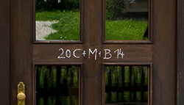
Equipping the Domestic Church
Office of Worship resources to come:
Christmas season blessings for meals (available now)
Prayer before opening gifts
Liturgy of the Word- reflection from Bishop Medley
Epiphany Blessing of Homes and Chalking the Door Service
Parishes could provide each family with a decorative package including one piece of chalk + the prayer resources to pick up after Mass
Consider keeping church open and lit an hour before and after Masses, and publicly advertise it, so families who can’t make it to Mass can come spend time in prayer or take a picture in the decorated church

Slide 10
Use of the Readings and Mass Texts in the Pandemic
These policies apply only to the United States of America (https://www.usccb.org/es/node/41922):
Through December 31, 2020, no permission is required for livestreaming of Masses (music not included) and the Divine Office via social media. As always, relevant liturgical law should be observed regarding the choice and use of texts.
Gratis permission is granted to include these texts in a downloadable or print worship aid through the conclusion of the current liturgical year (November 22, 2020). The texts must be reprinted verbatim and the appropriate copyright acknowledgment must be provided.
Permission will not be granted to project the readings or other Mass texts.
Families and individuals are encouraged to bring their own participation aids (hand missals, seasonal or monthly booklets, etc.) to Mass. Parishes or other groups may wish to coordinate bulk purchase and distribution of such resources if local health restrictions allow.
As of November 29, 2020, licensing will again be required to reprint the readings for Sundays and major feasts in a digital or paper worship aid. To obtain a license, please send an email to nabperm@usccb.org with “Sunday Readings License” as the subject. Provide the parish name and address along with the number of copies you will produce (or the average number of downloads if digital). Staff will reply as soon as possible with a license which will serve as your invoice. Please mail a check to the address given on the invoice (along with a copy of the invoice itself) to complete the order.

Slide 11
Office of Music
Mike Bogdan | Director of the Office of Music
270-852-8327
mike.bogdan@pastoral.org

Slide 12
Questions or ideas to share?

Slide 13
Office of Communications
Tina Kasey|Director of Communications
270-852-8331
tina.kasey@pastoral.org
Laura Rigsby |Digital Media Specialist
laura.rigsby@pastoral.org
Elizabeth Barnstead |Editor of The Western Kentucky Catholic
270-852-8334
elizabeth.barnstead@pastoral.org

Slide 14
Office of Hispanic Ministry
Dcn. Chris Gutierrez | Director of Office of Hispanic Ministry
270-852-8342
chris.gutierrez@pastoral.org

Slide 15
Questions or ideas to share?

Slide 16
Upcoming..
RCIA Coordinator Meeting: Rites in the Catechumenate
Tuesday, November 17th |10:30-11:30 AM
Lauren Johnson|Co-Coordinator
270-852-8366
lauren.johnson@pastoral.org
Fr. Brandon Williams |Co-Coordinator + Pastor of St. Leo Church, Murray
270-753-3876
brandon.williams@pastoral.org
Office of Worship

Slide 17
- Closing Prayer - Fr. Brandon Williams

