Slide 1
Roman Catholic Diocese of Owensboro
Open Enrollment Presentation

Slide 2
Mission and Core Values
Our mission is to build lasting relationships.
We provide prescription benefit management expertise at a personal and customized level to ensure optimum value at the lowest possible cost.

Slide 3
Welcome to TrueScripts
TrueScripts has partnered with your employer as your Prescription Benefits Manager (PBM).
It is our duty to lower costs and maximize the effectiveness of your prescription benefits plan.
This presentation, along with the TrueScripts Member Portal and Member Care team, are key resources.
Understanding how your plan works will help you get the most out of your benefits. We encourage you to reach out as needed.

Slide 4
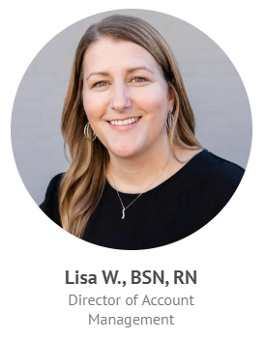
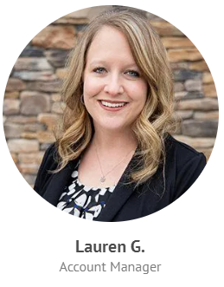
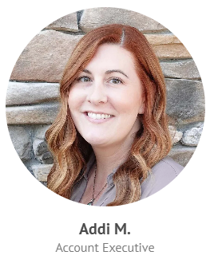
Your Dedicated Team

Slide 5
Amazing Member Care
Our high-touch approach is built to educate and inform so that, together, we can achieve solutions that are both cost and therapeutically effective for you.
99% One Ring Response^{tm} rate
Almost every call is answered on the very first ring by a live TrueScripts professional.
In-house Clinical Team
Our team of nurses, pharmacists, technicians, and care specialists are prepared to support you!
812-257-1955

Slide 6
Member Portal
The TrueScripts Member Portal gives you 24/7 access to helpful resources:
Drug Price Lookup Tool - Quickly and easily check real-time pricing on your medications so that you always get the best price!
Text and Live Chat - Receive money-saving updates, ask time-saving questions, and more.
Plan Documents - Access your plan structure to identify individual and family out-of-pocket and deductible amounts, as well as co-pay amounts for various types of drugs.
Claims Information - Track claims information, including co-pay totals, for you and your eligible dependents.
To register, go to memberportal.truescripts.com
Notes:
*BONUS – Members who register before February 1st will be entered to win a $100 Amazon Gift Card!

Slide 7
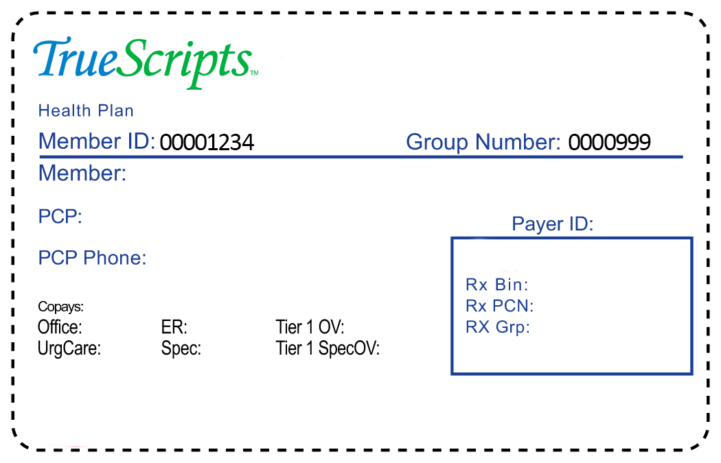
ID Cards
You will be receiving NEW insurance ID cards from Anthem which will have your updated TrueScripts processing information included.
Present this card to your pharmacy when filling prescriptions (including refills) on or after 1/1/2025.
Let the pharmacy staff know that you have NEW TrueScripts processing information. This will minimize any confusion or delays when filling your prescriptions.

Slide 8
Mail Order
Mail Order Member Education
Members may choose to receive prescription medications via mail order pharmacy by following the steps below. Note that there will be no changes in your plan setup:
1. Select the Mail Order Pharmacy of your choice and contact them to setup an account.
2. Have a list of your medications and prescribing doctors ready.
3. Provide the pharmacy with your NEW TrueScripts Processing information:
a. RxBin: 025862
b. RxPCN: TSAC
c. RxGroup: 99995847
d. Your Member ID number printed on your card
*Detailed instructions will be provided in a member flyer

Slide 9
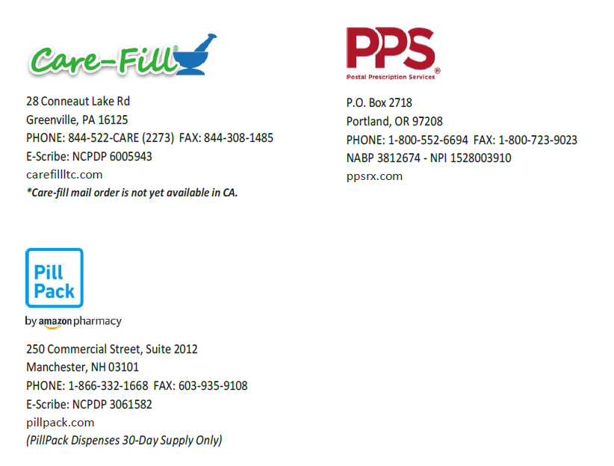
Mail Order Pharmacy Network

Slide 10
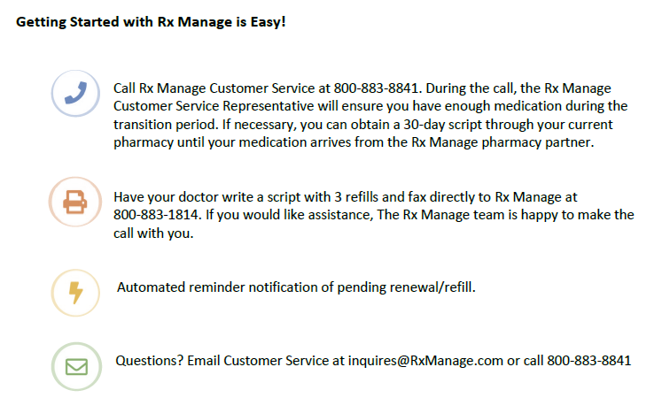
International Mail Order
Members being prescribed certain high-cost Brand medications can receive 90-day supplies shipped directly to their door at no cost.

Slide 11
Prior Authorizations
A Prior Authorization (PA) is a security measure to determine a drug’s clinical and financial efficiency.
If you have a prior authorization for a medication, please contact our Member Care team to prevent any disruption at the pharmacy.
If you are not sure if a prior authorization is in place for any of your current medications, please contact us, and we will verify if one is required.
Notes:
Once applicable information is received, Prior Authorizations are turned around in 24-48 hours.
We understand that members rely on timely access to their prescription medications. Our team works swiftly to ensure they receive the right drug, at the right time, for the right price.

Slide 12
Specialty Care Program
To help reduce the cost of expensive drugs, our team works with members to determine their eligibility for financial assistance. Here’s what to expect:
A TrueScripts Clinical Care Representative will reach out to obtain:
Household size
Gross annual household income
Physician information
Current pharmacy information
Qualifying members can receive their medication at NO COST to them!

Slide 13
Thank You!
Questions?

